Slide 1
Overview to the Economics Profession
By: Natalie Duncombe

Slide 2
Why a PhD in Economics?
“You should never forget that the purpose of a Ph.D. program in economics is to train you in the profession of economic research. Put differently, a Ph.D. program in economics is meant to train you to become a research professor in economics. It is not meant to train you to be a quant jock on Wall Street or a policy maker in Washington.”
- Stuart J. Hillmon, Getting a PhD in Economics

Slide 3
Good and Bad reasons for doing a PhD
Bad | Good
You're generally smart and did well in school but you don't know what to do next with your life. | You want to do economic research, you have questions you're interested in answering, and you have ideas about how to answer them.
You can't find a job, and it's a good holding pattern until you can get one (plus, you can get a master's degree in economics, which is as good as an M.B.A.). | You want to teach economics at the university level.
You want to make lots of money.
You want to work in public policy and save the world.
Source: Getting a PhD in Economics by Stuart Hillmon

Slide 4
Figuring out if Economics is right for you
1. What types of questions do they answer?
  Economists are not just experts but creators of economic knowledge.
  Economists cover all aspects of the domestics and international economy, what are you drawn to?
2. Where do economists work?
  Academia
  Public Policy and Government
  Private Sector
3. Why is their work important? Does that correspond with your goals?

Slide 5
Job Market Prospects
From 2016 AEA job listings:
  U.S. Jobs (929)
    Full-Time Academic (596)
      Restricted by field, level of experience
    Other Academic, Part-time or Adjunct (13)
    Other Academic, Visiting or Temporary (96)
    Full-Time Nonacademic Positions (224)
      Federal Reserve and other Government Agencies
      Consulting and other private companies like Amazon
  International Jobs (465)
Median Income – 120K (men), 80k (women)
Around 300 candidates graduating each year from top 15 schools
About 1,000 PhDs granted by US institutions in 2015
Low unemployment, even in recessions
Sources: U.S. Census, https://www.aeaweb.org/joe/listings.php

Slide 6
Types of Economist Jobs
Public Institutions – Federal and State Government
  Can be considered as academically prestigious as some positions in academia
  Able to see effects of research in action and more tangibly serve common good
Private Sector – Banks, Finance, Consulting, and other Corporations
  Offer more competitive benefits
  Can offer more fast paced environments, but not always as mission focused
Academia – Research Institutions
  Often considered the most prestigious jobs, especially those at top research institutions
  Advancement focuses on research production, teaching generally a secondary consideration
  Tough competition to receive tenure, but good job security if you get it
Academia – Teaching Institution
  Advancement weights research and teaching contributions equally
Job Market Candidates usually apply to all of the above then chose their best option

Slide 7
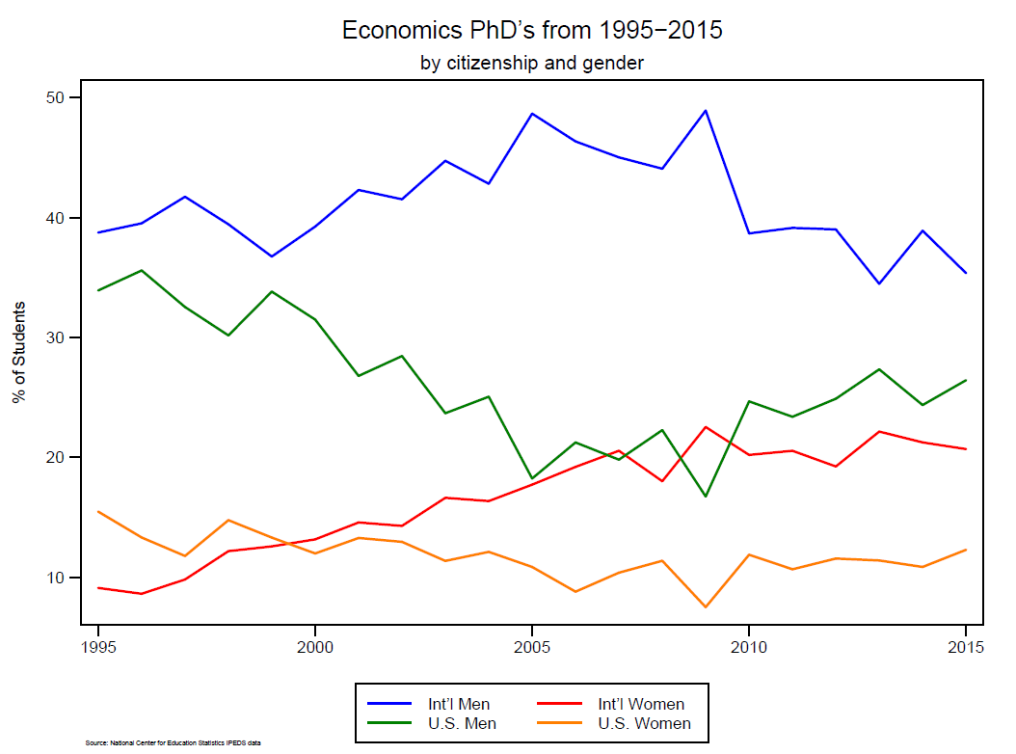
Who graduates from PhD programs?

Slide 8
Where do Economics PhDs graduate from?
10 Largest Programs
Rank | School | # of Graduates
1 | Stanford University | 29
2 | University of Chicago | 28
3 | University of Michigan | 27
4 | University of Wisconsin | 27
5 | UCSD | 25
6 | University of Minnesota | 25
7 | Boston University | 24
8 | Columbia University | 24
9 | Princeton University | 21
10 | New York University | 21
122 U.S. PhD granting institutions in the IPEDS data
17% of graduates went to a top 10 school*
39% of graduates went to a top 25 school*
*based on U.S. News Ranking
Source: NCES IPEDS, based on 2015 graduates

Slide 9
Where do Economics PhDs go to undergrad?
Top Worldwide Sources of Eventual Economics PhDs, 1997-2002
University | Country | Number of Eventual PhDs
Seoul National University | Korea | 162
Harvard University | USA | 74
National Taiwan University | Taiwan | 63
University of Delhi | India | 61
UC- Berkeley | USA | 54
Bocconi University | Italy | 45
Yonsei University | Korea | 44
Stanford University | USA | 40
Beijing University | China | 36
Cornell University | USA | 33
Source: “The Undergraduate origins of PhD Economists” Siegfried & Stock

Slide 10
Where do Economics PhDs go to undergrad?
Top American Sources of Eventual Economics PhDs, 1997-2003
University | Number of Eventual PhDs
Harvard University | 86
UC Berkeley | 69
Cornell University | 51
Stanford University | 51
University of Wisconsin-Madison | 46
University of Michigan | 40
Swarthmore College | 39
Yale University | 39
Princeton University | 37
MIT | 35
Source: “The Undergraduate origins of PhD Economists” Siegfried & Stock

Slide 11
Where do Economics PhDs go to undergrad?
Institution Size Normalized Top American Sources of Eventual Econ PhDs 1997-2003
University | Number of Eventual PhDs | Eventual PhDs per 1000 undergrad degrees
Swarthmore College | 39 | 15.12
Agnes Scott College | 7 | 9.08
Grinnell College | 20 | 9.04
Carleton College | 22 | 7.04
Williams College | 25 | 6.96
Harvard University | 86 | 6.88
Macalester College | 17 | 6.49
Princeton University | 37 | 4.78
Trinity University | 16 | 4.55
MIT | 35 | 4.46
Source: “The Undergraduate origins of PhD Economists” Siegfried & Stock

Slide 12
Considerations: Gender and Racial Disparities in Economics

Slide 13
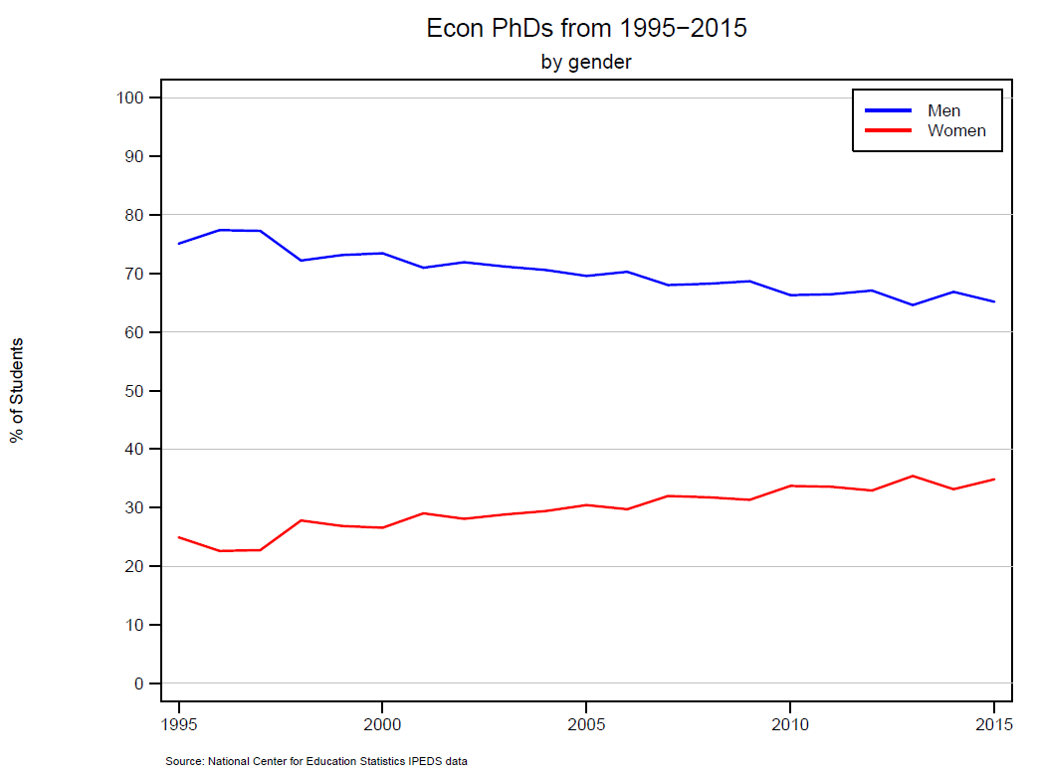
Gender Disparity
Notes:
Economics is pretty Male, but what does this mean?

Slide 14
Consequences of Gender Disparity
  Some highlights from Diversity in the Economics Profession: a New Attack on an Old Problem by Amanda Bayer (Swarthmore, and visiting R&S) and Cecilia Elena Rouse
  Economics has the largest gender gap in tenure rates, salaries, and job satisfaction compared to other math-intensive fields.
  Reported 20% gender gap in achieving tenure and 50% gap in promotion to full professor (social sciences overall are 12% and 25%).
  Women account for 13% of authorships in economics since 1990.
  An additional coauthored paper for a man has the same effect on the likelihood of tenure as a solo-authored paper, women suffer a significant penalty for coauthoring, especially when their coauthors are men (Sarsons 2015).
Link: http://pubs.aeaweb.org/doi/pdfplus/10.1257/jep.30.4.221
Notes:
The paper goes into depth about why some of these conditions may occur and offers some solutions.

Slide 15
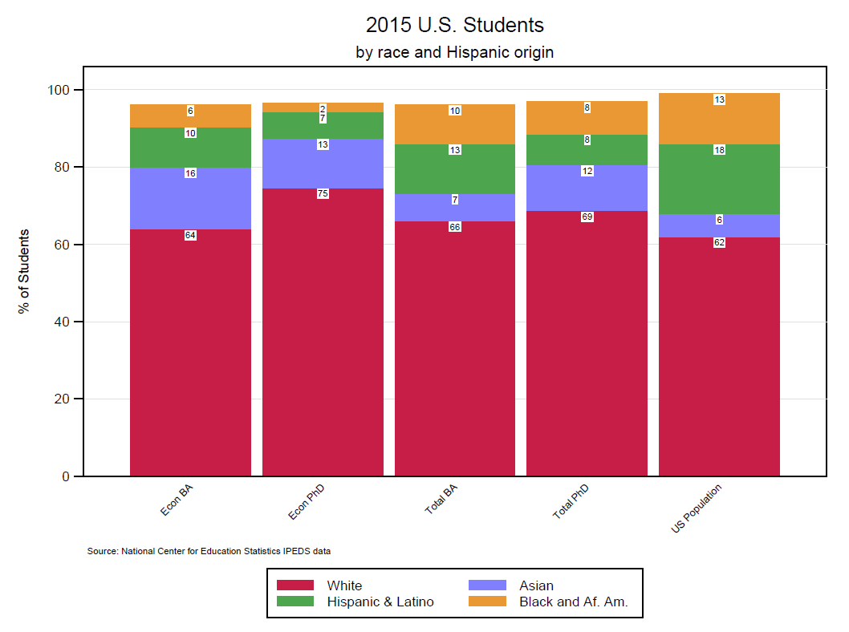
Low Minority Representation
Note: Gaps to 100% represent “other”, should probably fix…

Slide 16
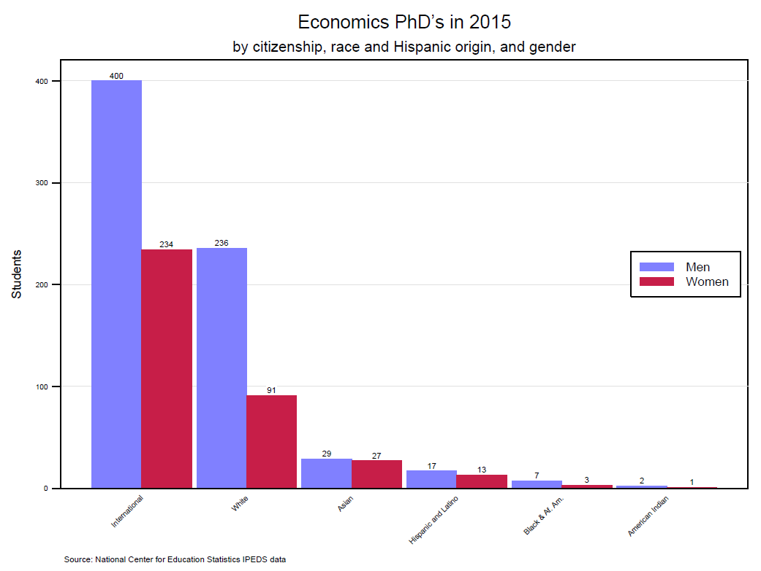
Interaction of Disparities

Slide 17
School Rankings by Gender Inclusion
Top 15 Schools re-ranked by inclusion of women from 2010-2015
Rank | School | % Female Students | % Female Econ Faculty
1 | Columbia University | 38 | 17
2 | University of California-San Diego | 36 | 17
3 | Massachusetts Institute of Technology | 32 | 13
4 | University of Pennsylvania | 32 | 14
5 | University of Wisconsin-Madison | 30 | 17
6 | University of Michigan-Ann Arbor | 30 | 12
7 | Yale University | 30 | 12
8 | University of California-Berkeley | 30 | 12
9 | University of California-Los Angeles | 27 | 20
10 | Harvard University | 27 | 12
11 | Stanford University | 26 | 14
12 | Princeton University | 24 | 9
13 | New York University | 21 | 9
14 | University of Chicago | 20 | 8
15 | Northwestern University | 13 | 15
Below Average for % Female Students
Source: NCES IPEDS, based on total graduates from 2010-2015 and rankings from US News Rankings,

Slide 18
School Rankings by Racial Inclusion
Top 15 Schools re-ranked by inclusion of domestic students of color from 2010-2015
Rank | School | % POC* | # POC
1 | Princeton University | 42 | 11
2 | Stanford University | 33 | 19
3 | Columbia University | 30 | 14
4 | Massachusetts Institute of Technology | 30 | 16
5 | University of California-Berkeley | 28 | 19
6 | University of Wisconsin-Madison | 25 | 7
7 | Harvard University | 25 | 15
8 | University of Chicago | 23 | 11
9 | University of Michigan-Ann Arbor | 22 | 17
10 | University of Pennsylvania | 21 | 7
11 | Northwestern University | 19 | 6
12 | University of California-Los Angeles | 18 | 7
13 | University of California-San Diego | 15 | 10
14 | Yale University | 13 | 4
15 | New York University | 6 | 1
Below Average for % POC
Source: NCES IPEDS, based on total domestic graduates from 2010-2015 and rankings from US News Rankings, * This is the percent of U.S. students who are People of Color (POC), non-white domestic students

Slide 19
Things to consider
Positives | Negatives
Economics is really interesting | Things probably won’t change quickly
Good work life balance | Possible lower job satisfaction, frustration
Strong job market prospects | Isolation
High median pay, despite the gap | You have to be better to get to the same place
Resources might not be available in your workplace, but there are national resources such as through the AEA’s Committee on the Status of Women in the Economics Profession and Committee on the Status of Minority Groups, and the American Society of Hispanic Economists (ASHE) | Can’t expect support or acknowledgement of gender divide (from either gender) - “There seems to be greater hostility or at best indifference to the problems that women in particular face in the economics profession, perhaps because economic theory finds it very difficult to explain continued discrimination against any group if it entails a productivity cost” – Stuart Hillmon

Slide 20
Things to consider
Will positives outweigh negatives?
What individual actions can you take to minimize the negatives and maximize the positives?
  Chose programs where you will be successful, not just based on ranking
  Reach out to mentors and look for external support
  Give yourself maximum flexibility when you enter the job market
  Really hone your passion for research
What conditions will you have to accept as immutable? How important do you think this will be?
  If you are not promoted, will your work still be satisfying?
  If it is hard for you to publish, will your work still be satisfying?
  If you end up as the only person “like you” in your department or section, will you have external support?

